Slide 1
Something new: Casting & Ranges of primitives
Mr. Neat
Java
Mr. Neat
Java

Slide 2
Ranges of primitives: ints
the maximum value that an int variable can take on is the same for all Java programs
it is stored in a constant: Integer.MAX_VALUE (for min, Integer.MIN_VALUE)
four bytes long
the Max value is:2147483647 = (2³¹-1)
the Min value is: - 2³¹

Slide 3
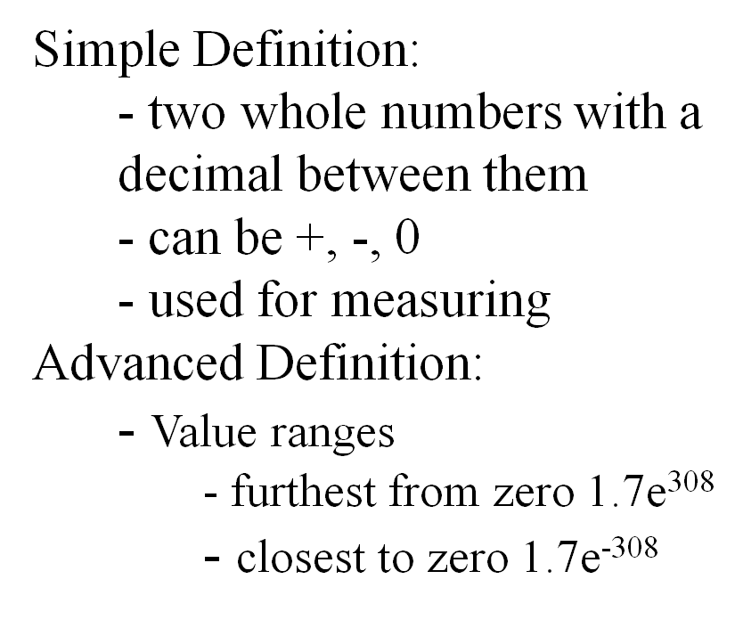
Ranges of primitives: doubles

Slide 4
New Idea: static methods!
no need to construct object of class
call method using class name as the object
no object of that class needs to exist
System.out.print(Canvas.rand(100));

Slide 5
Look at the Canvas rand method definition...
public static int rand(int r)
{
return (int)(Math.random()*r);
}
Let’s analyze this

Slide 6
Look at the Canvas rand method definition...
(int)(Math.random()*r);
Math is a static class
call all Math methods with class name
random() is one Math method
random returns a double from 0 to 1
including 0 but not including 1

Slide 7
Other Math Methods...
Math.abs()
Math.power(a,b)
Math.sqrt(s)
Math.min(c, d);
Math.max(e, f);

Slide 8
Look at the Canvas rand method definition...
(int)(Math.random()*r);
r is an integer multiplier
Math.random() is like taking a percent of r

Slide 9
Look at the Canvas rand method definition...
(int)(Math.random()*r);
this produces a double
the value is some % of r
for example, 17.5

Slide 10
Look at the Canvas rand method definition...
(int)(Math.random()*r);
this command “casts” the double to an integer
casting a double to an integer has the effect of chopping off the decimal
for example, (int)(17.5) = 17
So the above expression generates random integers from (and including) 0 up to (and including) r - 1

Slide 11
Another Example...
int john;
double sam;
EasyReader sue = new EasyReader();
sam = sue.readDouble();
john = (int)sam;
casting
(truncates towards zero)
If sam = 5.9, john = 5!

Slide 12
Lab
Review your Frogger Final program and eliminate all calls to Canvas.rand(). Replace with direct calls to Math.random().
Comment out the old call to make it easier to fix if you get errors.
Run the code and verify you didn’t break it
In the future, use the direct call if you would like. I don’t care

